Slide 1
An Introduction to Safeguarding Children, Young People and Adults at risk
Created by the RYA Safeguarding Team Version 1

Slide 2

Learning Outcomes
Have a good understanding of what safeguarding is and why it is important
Understand why safeguarding is everyone’s responsibility
Know how to make a referral and who to contact if you have any concerns
Understand the principles surrounding confidentiality, information sharing and consent in adults
Notes:
Presenter – talk through the learning outcomes and invite participants to offer any concerns they may have – you can re-visit these at the end of the session to make sure that any worries or concerns have been resolved

Slide 3

Self Care
Safeguarding can be an emotive subject and the content can sometimes be difficult to hear
If you feel uncomfortable and need to take a break, please do so
If you need to step away, the facilitator will check on you and see if you are able to continue
Notes:
Presenter – remind the participants that they can leave if they find the content difficult

Slide 4
Some Useful Safeguarding Definitions | Some Useful Definitions
Child | Someone who is under the age of 18 who has a right to be protected in law. It’s important to remember that all children and young people are potentially vulnerable.
Adult | Someone who is 18 years or over
Adult at Risk | Has needs for care and support (whether or not the local authority is meeting any of those needs) and is experiencing, or is at risk of, abuse or neglect; and; As a result of those care and support needs is unable to protect themselves from either the risk of, or the experience of, abuse or neglect.
Safeguarding | Safeguarding means preventing and protecting children and adults at risk from abuse or neglect and educating those around them to recognise the signs and dangers.
Child Protection | Child Protection is part of the safeguarding children process, protecting individual children identified as suffering or likely to suffer significant harm. This includes the child protection procedures which detail how to respond to concerns about a child.
Notes:
Presenter – Read through the terms and their definitions

Slide 5
Why is Safeguarding Important?
As our club / centre works with vulnerable groups (children, young people and adults at risk), we have a duty of care to ensure that all those we support are protected from abuse, neglect and harm.
We have stringent policies, processes and procedures to ensure that our club / centre has an imbedded safeguarding culture throughout its members, staff and or volunteer teams.
Having a safe culture protects everyone and protects us against reputational damage and loss of funds
Notes:
Presenter – read through why safeguarding is important

Slide 6

Positions of Trust – A Change to the Law
A “position of trust” is a legal term that refers to certain roles and settings where an adult has regular and direct contact with children such as teachers, doctors, social workers and care workers
In England, Wales and Northern Ireland changes to the law made in 2022 extend the definition to include sports coaches and faith leaders
It is now against the law for someone in a position of trust to engage in sexual activity with a child in their care, even if that child is over the age of consent (16 or over).
Notes:
Presenter to read through the slide and discuss appropriate relationships. RYA to provide further information surrounding PoT as it becomes available

Slide 7

How does safeguarding adults differ from safeguarding children and young people?
Safeguarding Adults:
Adults have the right to live the lives they choose, even if that life is considered risky
If they have capacity, they can insist that confidentiality cannot be broken (they have the right to this)
However, if a crime has been committed, someone is in danger or likely to put others in danger, you can break confidentiality
Notes:
Presenter – read through the slide.

Slide 8

What is mental capacity and what does it mean?
As an adult, having mental capacity means being able to make and communicate your own decisions.
Someone may lack mental capacity if they can’t:
Understand information about a particular decision
Remember that information long enough to make the decision
Weigh up the information to make the decision or communicate their decision.
Notes:
Presenter – Read through the slide

Slide 9
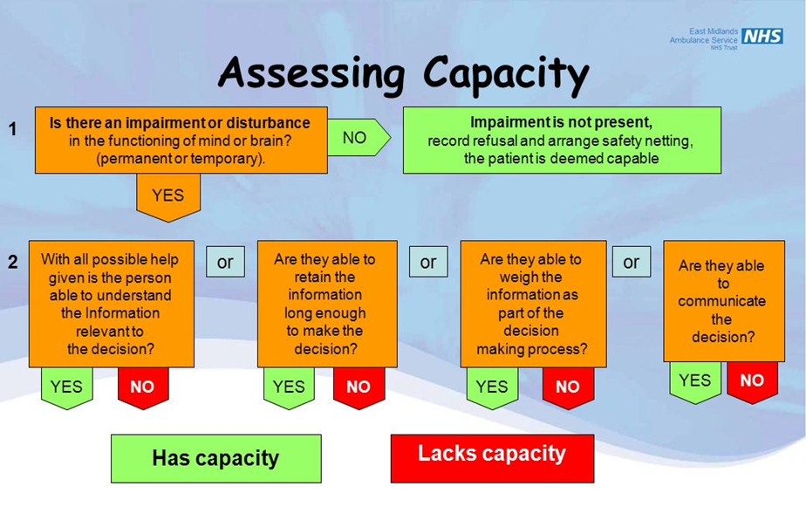
Assessing Capacity – An NHS Guide
Notes:
Presenter – Ask the group to read through the slide and answer any questions they may have

Slide 10

But what’s it got to do with me?
Safeguarding is everyone’s responsibility regardless of who you are and what you do
It is important that you understand what safeguarding is and what to do if someone makes a disclosure to you or you identify that someone may be experiencing abuse or harm.

Slide 11

What do I need to do?
Know how to recognise abuse and how to respond
Know who the Club Welfare Officer is and how to contact them
Know who the RYA Safeguarding Team is and how to contact them
Understand that there is always someone to talk to if you have a concern
Notes:
Presenter – go through the slide

Slide 12
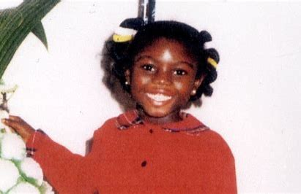
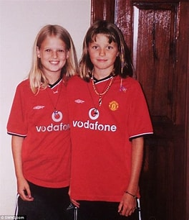
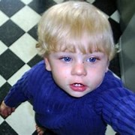
Confidentiality, Information Sharing and Consent
Information sharing is essential for effective safeguarding and promoting the welfare of children, young people and adults at risk. It is a key factor identified in many Serious Case Reviews (SCRs), where poor information sharing has resulted in missed opportunities to take action that keeps vulnerable groups safe.
Notes:
Presenter – manage the participants worries and concerns about sharing information. Reiterate that not sharing is not an option using Victoria Climbe, Holly Wells and Jessica Chapman and Baby Peter

Slide 13
Types of Abuse
Adults | Children
Physical Abuse Sexual Abuse Neglect / Acts of Omission Domestic violence or abuse Psychological or emotional abuse Financial or material abuse Modern slavery Discriminatory abuse Organisational or institutional abuse Self-neglect | Physical Abuse Sexual Abuse and Exploitation Neglect Emotional / Psychological Abuse
Notes:
Presenter – go through the different types of abuse for adults and children – consider adding some signs and indicators of each type of abuse or split into groups and ask each group to chat and feed back.

Slide 14
How to respond to a safeguarding disclosure
DOING NOTHING IS NEVER AN OPTION
Being the recipient of a safeguarding disclosure can be incredibly difficult, especially if the recipient is not a Safeguarding Lead. However, choosing not to respond to a disclosure can never happen, regardless of how uncomfortable the recipient is.
Notes:
Presenter – read through the slide

Slide 15
Dos and Don’ts when dealing with a disclosure
Do | Don’t
Listen carefully and trust what the person is telling you implicitly | Tell the person you will keep what they have told you a secret
Thank the person for telling you and offer them reassurance that you will help them | Panic, overreact, be judgmental, make assumptions or put words in the person's mouth
Make a written factual record asap using the persons own words where possible | Investigate the allegations or ask the victim to repeatedly go over the facts
Share your concerns with the Club Welfare Officer or the RYA Safeguarding Team | Discuss the disclosure with people who do not need to know
Remember, if a crime has been committed call the police straight away
Notes:
Presenter – read through the slide

Slide 16
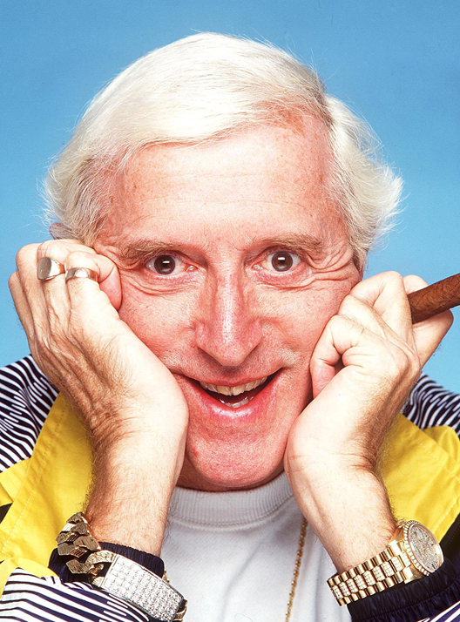
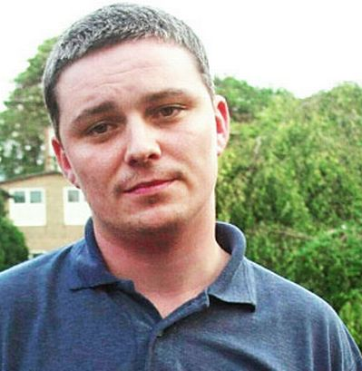
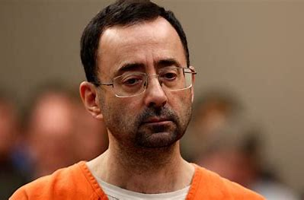
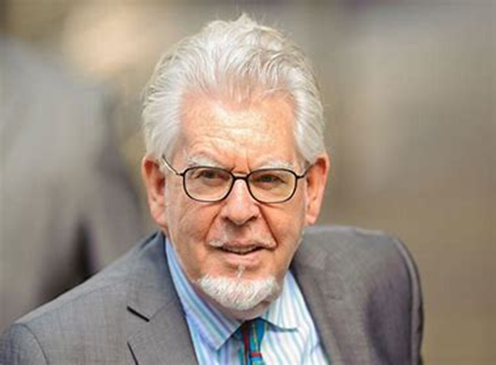
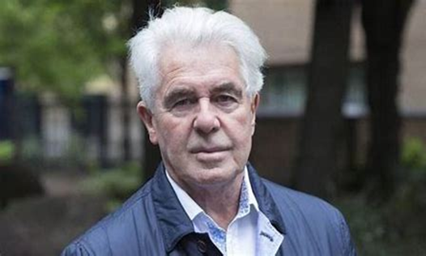
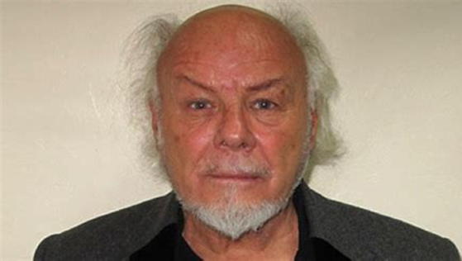
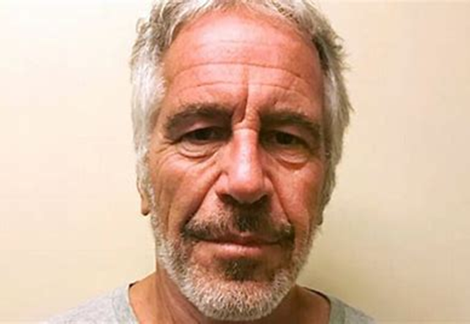
No matter how long you have known someone or how well you think you know them, YOU DON’T!
Notes:
Presenter – Really make an emphasis on this subject, make reference to the pictured sex offenders who were often well known and well trusted

Slide 17
Who should I report a concern to?
The Club Welfare Officer
[Insert Details]
The RYA Safeguarding Team
Katie Loucaides – RYA Safeguarding and Equality Manager
Andrea Gates – RYA Safeguarding Officer
Amy Lowbridge – RYA Safeguarding and Equality Senior Administrator
02380 604297 / safeguarding@rya.org.uk
Notes:
Presenter – Talk through the slide

Slide 18

Keep yourself safe and avoid putting yourself at risk
Never be unsupervised with children & adults at risk
Avoid using showers / changing facilities where children are present
Mind your language
Avoid handling children and adults at risk
Don’t take photographs and videos without consent
Notes:
Presenter – reiterate that safeguarding is just as much about keeping yourself safe as keeping others safe – Additionally, you could use different examples of people putting themselves at risk: an adult alone with a child in a changing room, transporting children alone in a car, helping children to dress / undress etc

Slide 19
Scenario discussions
Part 1
You are walking across the club grounds towards the changing rooms. As you get closer, you notice Nigel, a 65-year-old volunteer coming out of the boys' changing rooms with his phone in his hand. He does not have a bag and does not appear to have been sailing.
What do you think about this situation and what would your immediate actions be?
Notes:
Presenter – talk through the slides and work your way through the three parts of the scenario – encourage group discussions at each stage

Slide 20
Scenario discussions
Part 2
You are shocked by what you see, but Nigel has disappeared, as you walk into the restaurant, you notice that Nigel is looking at his phone. As you approach, you can see a naked image of one of the young sailors.
What will you do now?

Slide 21
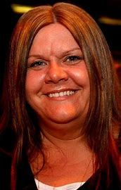
Scenario discussions
Part 3
Going back to part 1 of this scenario, if Nigel had been a 35-year-old female, coming out of the girls' changing rooms, would your thoughts and subsequent actions have been any different.
Remember to check your bias at the door when thinking about safeguarding. Not everyone with malicious intentions are older males. Does everyone remember nursery worker Vanessa George?
Notes:
Presenter – remind everyone about the case with Vanessa George and how abuse can happen anywhere and even from young people against young people.

Slide 22

Just to recap….
If it doesn’t quite feel right, pass on your concerns
Remain watchful and vigilant
Keep yourself safe
Receive, respond & refer
Adults have the right to live the life they choose
Never promise to keep secrets
It is now a criminal offence for a person in a position of trust to engage in sexual activity with a child
Notes:
Presenter – talk through the slide and revisit any concerns held by participants

Slide 23
Further Signposting
Organisation Name | Contact Details
RYA Safeguarding Team Dedicated team of subject matter experts available for support and guidance | Tel: 02380 604297 Email: safeguarding@rya.org.uk RYA Safeguarding Referral Form
NSPCC 24-hour helpline The UK's leading children's charity, preventing abuse and helping those affected to recover. | Tel: 0808 800 5000 E-mail: help@nspcc.org.uk
Children 1st Scotland A helping hand for every family in Scotland | Tel: 0800 028 2233 (9am – 9pm Mon – Fri) E-mail: parentlinescotland@children1st.org.uk
Supportline Support for children, young adults and adults including those affected by sexual, emotional, and physical abuse. | Tel: 01708 765200 www.supportline.org.uk
Samaritans Emotional support for people who are experiencing feelings of distress, despair, or suicide. | Tel: 08457 90 90 90 (24hrs)
Notes:
Close session down and reiterate contact details of CWO

